Slide 1
AVL Trees: Implementation
struct AvlNode;
typedef struct AvlNode *Position;
typedef struct AvlNode *AvlTree;
AvlTree MakeEmpty( AvlTree T );
Position Find( ElementType X, AvlTree T );
Position FindMin( AvlTree T );
Position FindMax( AvlTree T );
AvlTree Insert( ElementType X, AvlTree T );
AvlTree Delete( ElementType X, AvlTree T );
ElementType Retrieve( Position P );

Slide 2
AVL Trees: Implementation
struct AvlNode
{
ElementType Element;
AvlTree Left;
AvlTree Right;
int Height;
};

Slide 3
AVL Trees: Implementation
int Height(Position P )
{
if( P == NULL )
return -1;
else
return P->Height;
}

Slide 4
AVL Trees: Implementation
AvlTree Insert( ElementType X, AvlTree T )
{ if ( T == NULL )
{ /* Create and return a one-node tree */
T = new AvlNode;
T->Element = X;
T->Left = T->Right = NULL;
}
else

Slide 5
AVL Trees: Implementation
if( X < T->Element )
{
T->Left = Insert( X, T->Left );
if( Height( T->Left ) - Height( T->Right ) == 2 )
if( X < T->Left->Element )
T = SingleRotateRight( T );
else
T = DoubleRotateWithLeft( T );
}

Slide 6
AVL Trees: Implementation
else
if( X > T->Element )
{
T->Right = Insert( X, T->Right );
if( Height( T->Right ) - Height( T->Left ) == 2 )
if( X > T->Right->Element )
T = SingleRotateLeft( T );
else
T = DoubleRotateWithRight( T );
}

Slide 7
AVL Trees: Implementation
/* Else X is in the tree already; we'll do nothing */
T->Height = Max( Height( T->Left ), Height( T->Right ) ) + 1;
return T;
}

Slide 8
AVL Trees: Implementation
Position SingleRotateLeft( Position K1 )
{
Position K2;
K2 = K1->Right;
K1->Right = K2->Left;
K2->Left = K1;
K1->Height = Max( Height(K1->Left), Height(K1->Right) ) + 1;
K2->Height = Max( Height(K2->Right), K1->Height ) + 1;
return K2; /* New root */
}

Slide 9
Case 1: Right heavy (RR)
Add value 60
Left rotation is performed
K1
20
20
K2
10
40
10
40
30
50
30
50
60

Slide 10
Case 1: Right heavy (RR)
Resulting Tree after left Rotation
K2
40
K1
20
50
10
30
60

Slide 11
AVL Trees: Implementation
Position SingleRotateRight( Position K1 )
{
Position K2;
K2 = K1->Left;
K1->Left = K2->Right;
K2->Right = K1;
K1->Height = Max( Height(K1->Left), Height(K1->Right) ) + 1;
K2->Height = Max( Height(K2->Left), K1->Height ) + 1;
return K2; /* New root */
}

Slide 12
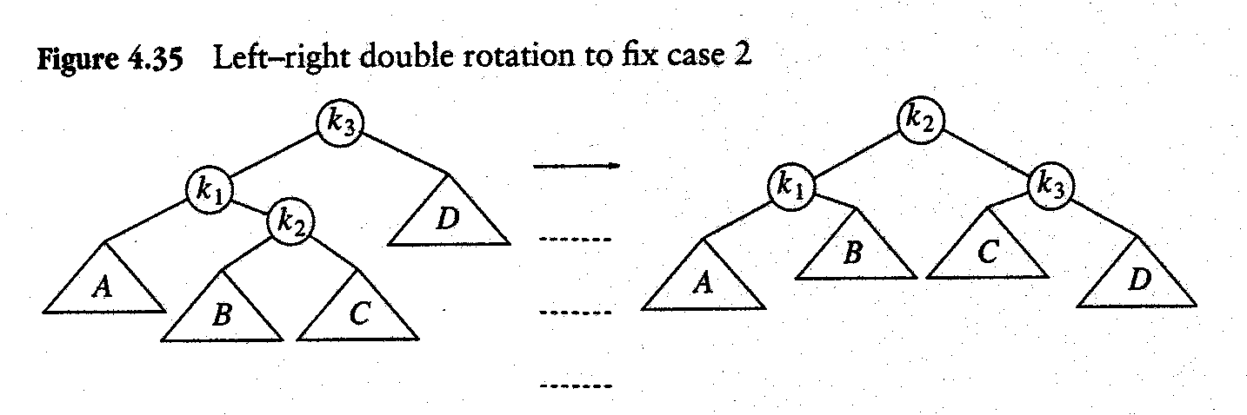
AVL Trees: Implementation
Position DoubleRotateWithLeft( Position K3 )
{
/* Rotate between K1 and K2 */
K3->Left = SingleRotateLeft( K3->Left );
/* Rotate between K3 and K2 */
return SingleRotateRight( K3 );
}
Single Left Rotation at K1
Single Right rotation at K3

Slide 13
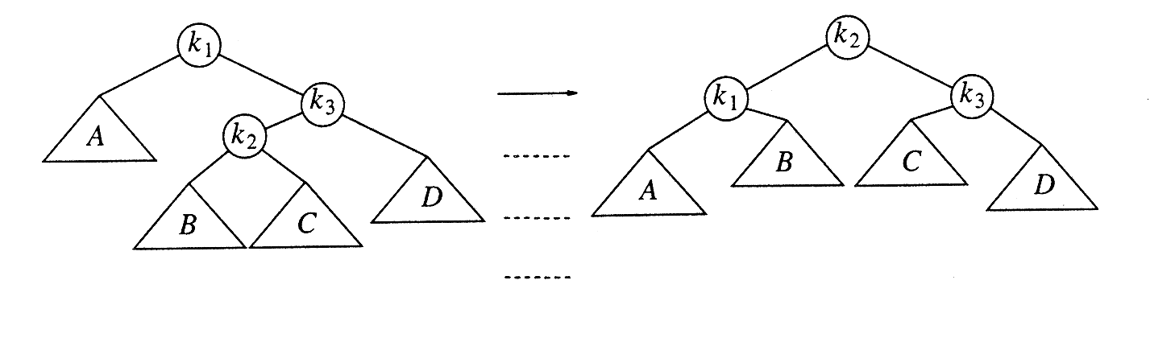
AVL Trees: Implementation
Position DoubleRotateWithRight( Position K1)
{
/* Rotate between K3 and K2 */
K1->Right = SingleRotateRight( K1->Right );
/* Rotate between K1 and K2 */
return SingleRotateLeft( K1 );
}

Slide 14
Case: Left heavy (LR)
Adding node 22
Requires double rotation!
40
40
20
50
20
50
10
30
60
10
30
60
25
35
25
35
22

Slide 15
Case 2:Left heavy
40
40
K1
K1
20
50
20
50
K3
K2
10
30
60
10
25
60
K2
K3
25
35
22
30
22
35

Slide 16
Case 2:Left Subtree is higher
40
40
K1
K2
20
50
25
50
K2
K1
K3
10
25
60
20
30
60
K3
22
30
10
22
35
35

Slide 17
AVL Tree Deletion

Slide 18
AVL tree - deletion
To be an AVL tree, must always:
(1) Be a binary search tree
(2) Satisfy the height constraint
Suppose we start with an AVL tree, then delete as a regular BST.
Will the tree be an AVL tree after the delete?
(1) It will still be a BST… that’s one part.
(2) Will it satisfy the height constraint?

Slide 19
BST Delete breaks an AVL tree
7
7
Delete(9)
4
9
4
3
3
NOT an AVL tree!

Slide 20
What else can BST Delete break?
Balance factors of ancestors…
7
0
1
7
1
Delete(3)
4
9
0
1
4
9
1
0
0
0
3

Slide 21
Need a new Delete algorithm
We are starting to see what our delete algorithm must look like.
Goal: if tree is AVL before Delete, then tree is AVL after Delete.
Step 1: do BST delete.
This maintains the BST property, but can BREAK the balance factors of ancestors!
Step 2: fix the balance constraint.
Do something that maintains the BST property, but fixes any balance factors that are < -1 or > 1.

Slide 22
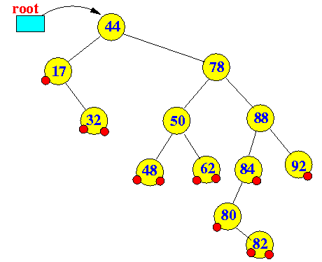
BST delete example (Review)

Slide 23
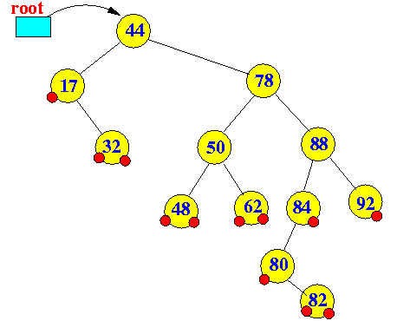
Deleting a leaf node (no children nodes): easy, just delete away....

Slide 24
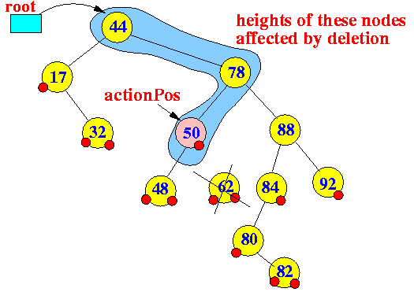
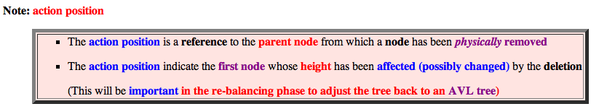

Slide 25
Deleting a node with 1 child node: easy, connect its parent and child....

Slide 26
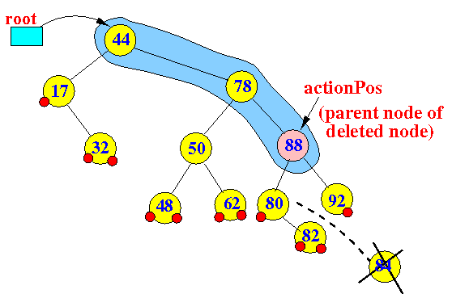

Slide 27
Deleting a node with 2 children nodes

Slide 28
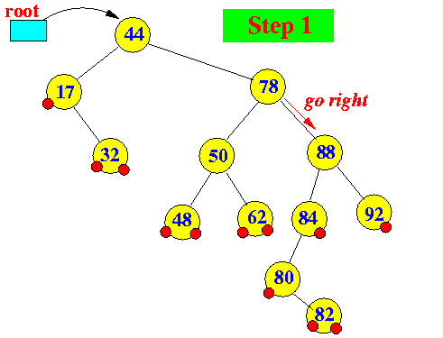
Deleting a node with 2 children nodes

Slide 29
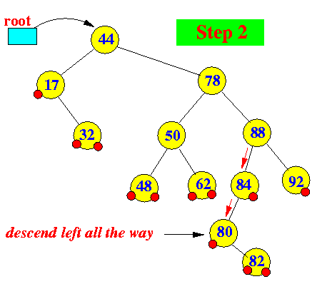

Slide 30
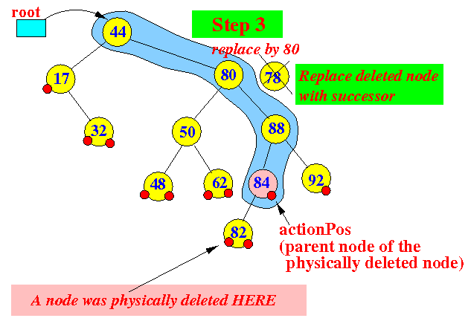

Slide 31
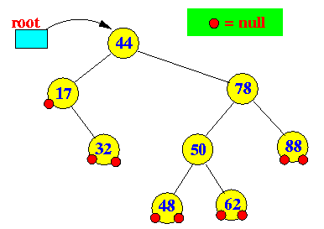
Deletion in an AVL tree can also cause imbalance

Slide 32
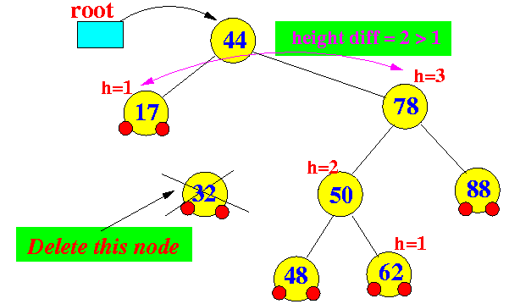
Deleting an entry (node) can also cause an AVL tree to become height unbalanced:

Slide 33
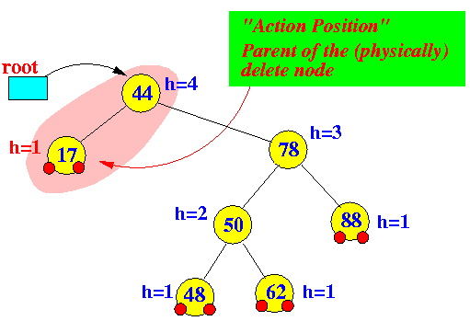
The height changes at only nodes between the root and the parent node of the physically deleted node

Slide 34
Re-balancing the AVL tree after a delete operation:
Just like insert operation, we can use the rotations to re-balance an out-of-balanced AVL tree.
How to apply the rotations is a bit tricky in the delete operation.

Slide 35
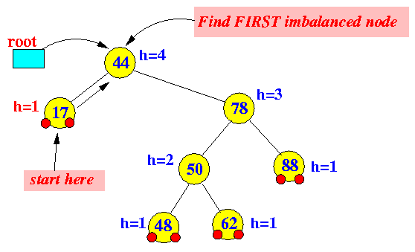
Re-balancing an AVL tree after deletion: Starting at the action position (= parent node of the physically deleted node), find the first imbalanced node (This step is exactly the same as in insert)

Slide 36
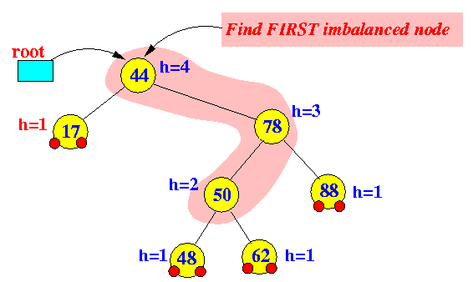
Re-balancing an AVL tree after deletion: Perform a rotation using these 3 nodes (shaded):

Slide 37
Re-balancing an AVL tree after deletion: Perform a rotation using these 3 nodes (shaded):
a
b
c

Slide 38
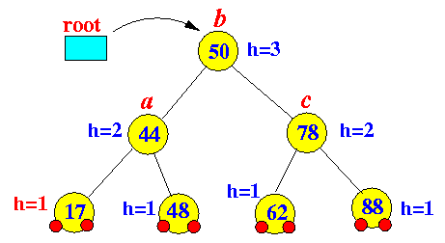
Re-balancing an AVL tree after deletion: The tree after the rotation is:

Slide 39
Pre-conditions for applying rotations to re-balance an AVL tree:
Node a or x = the first imbalanced node from the action position (= parent of the physically inserted/deleted node) to the root.
Node b or y = the child node of node a that has the higher height
Node c or z = the child node of node b that has the higher height

Slide 40
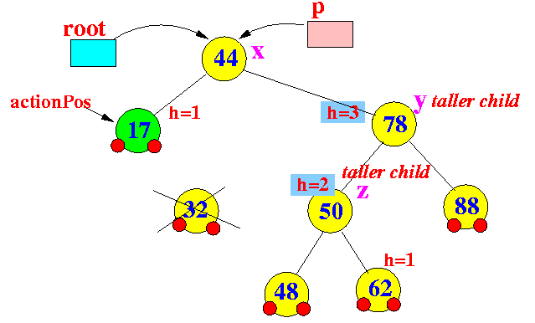

Slide 41
Further re-balancing required for the delete operation
We just saw that:
The imbalance at the first imbalance node due to a deletion operation can be restored using rotation
However:
The resulting subtree does not have the same height as the original subtree !!!
Consequently:
Nodes that are further up the tree are re-balanced by the re-balancing of the first imbalanced node !!!

Slide 42
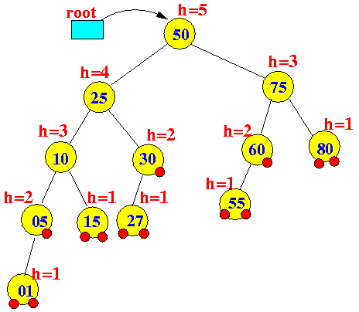

Slide 43
Notice that the original height of this (shaded) subtree is 2

Slide 44
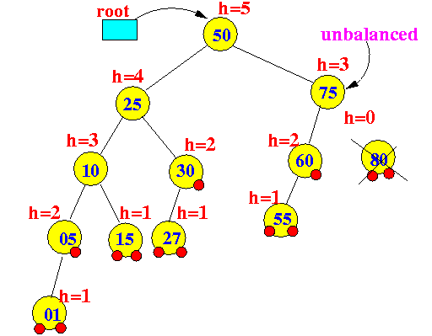
Delete the node 80

Slide 45
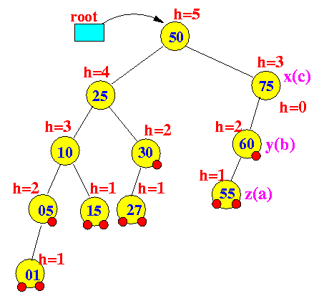
Delete the node 80

Slide 46
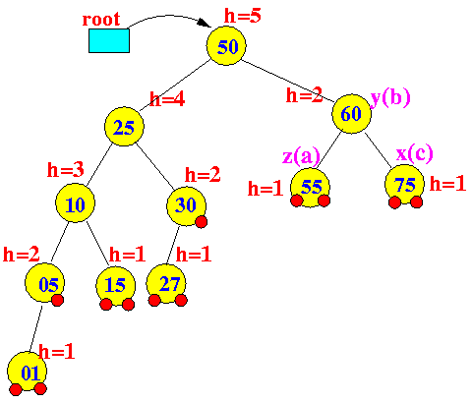
Delete the node 80

Slide 47
original height of this (shaded) subtree was 2

Slide 48
Delete the node 80
Resulting height of this (shaded) subtree is 1

Slide 49

Delete the node 80

Slide 50
Node a or x = the first imbalanced node from the action position (= parent of the physically inserted/deleted node) to the root. Node b or y = the child node of node a that has the higher height Node c or z = the child node of node b that has the higher height

Slide 51
Delete the node 80

Slide 52
Homework
Write C++ code for:
AVL Delete
Finding Min
Finding Max
Finding Height of a node if we do not have height member in structure definition
Finding Depth of a node
Checking if a given BST is AVL
Checking if a given binary tree is AVL

Slide 53
“He who asks a question is a fool for five minutes; he who does not ask a question remains a fool forever”
Chinese Proverb
Questions?
“The wise man doesn't give the right answers, he poses the right questions.” Claude Levi-Strauss
“A wise man can learn more from a foolish question than a fool can learn from a wise answer.” Bruce Lee

